Slide 1
All material in this document is a copyright of Modern Management Institute, and is being distributed only to attendees of our training events.
Recipients of this document are NOT permitted to redistribute this material or to use it for other training class or workshop – with or without change. It is also not permitted to use parts of this presentation or slides in your own training material, presentations or publications without our express written consent.
It takes many years of hard work, sustained investment of time & money to create expertise. Please help respect that expertise and prevent IP and copyright infringements. Together we can make a difference.

Slide 2
Scrumban
(Scrum+Kanban)
Game

Slide 3
Ask Your Neighbor:
What do you
already know
about Scrum+ Kanban?
Pair
up, introduce yourselves
and tell each other…
Notes:
Ask participants to pair
up, introduce themselves
and tell each other what
they already know about Scrum.

Slide 4
What will I get out of the Scrumban game?
What principles and practices are needed to to define and visualize flow in a Scrum environment using Kanban.
How to apply Kanban practices to your work.
The importance and key techniques of limiting Work in Progress.
Learn patterns for how to infuse Kanban’s thinking and practices into the Scrum events, artifacts, and roles.
Modern forecasting techniques to balance the demand and the capacity of the team

Slide 5
Introductions
Who we are and why we’re here.

Slide 6
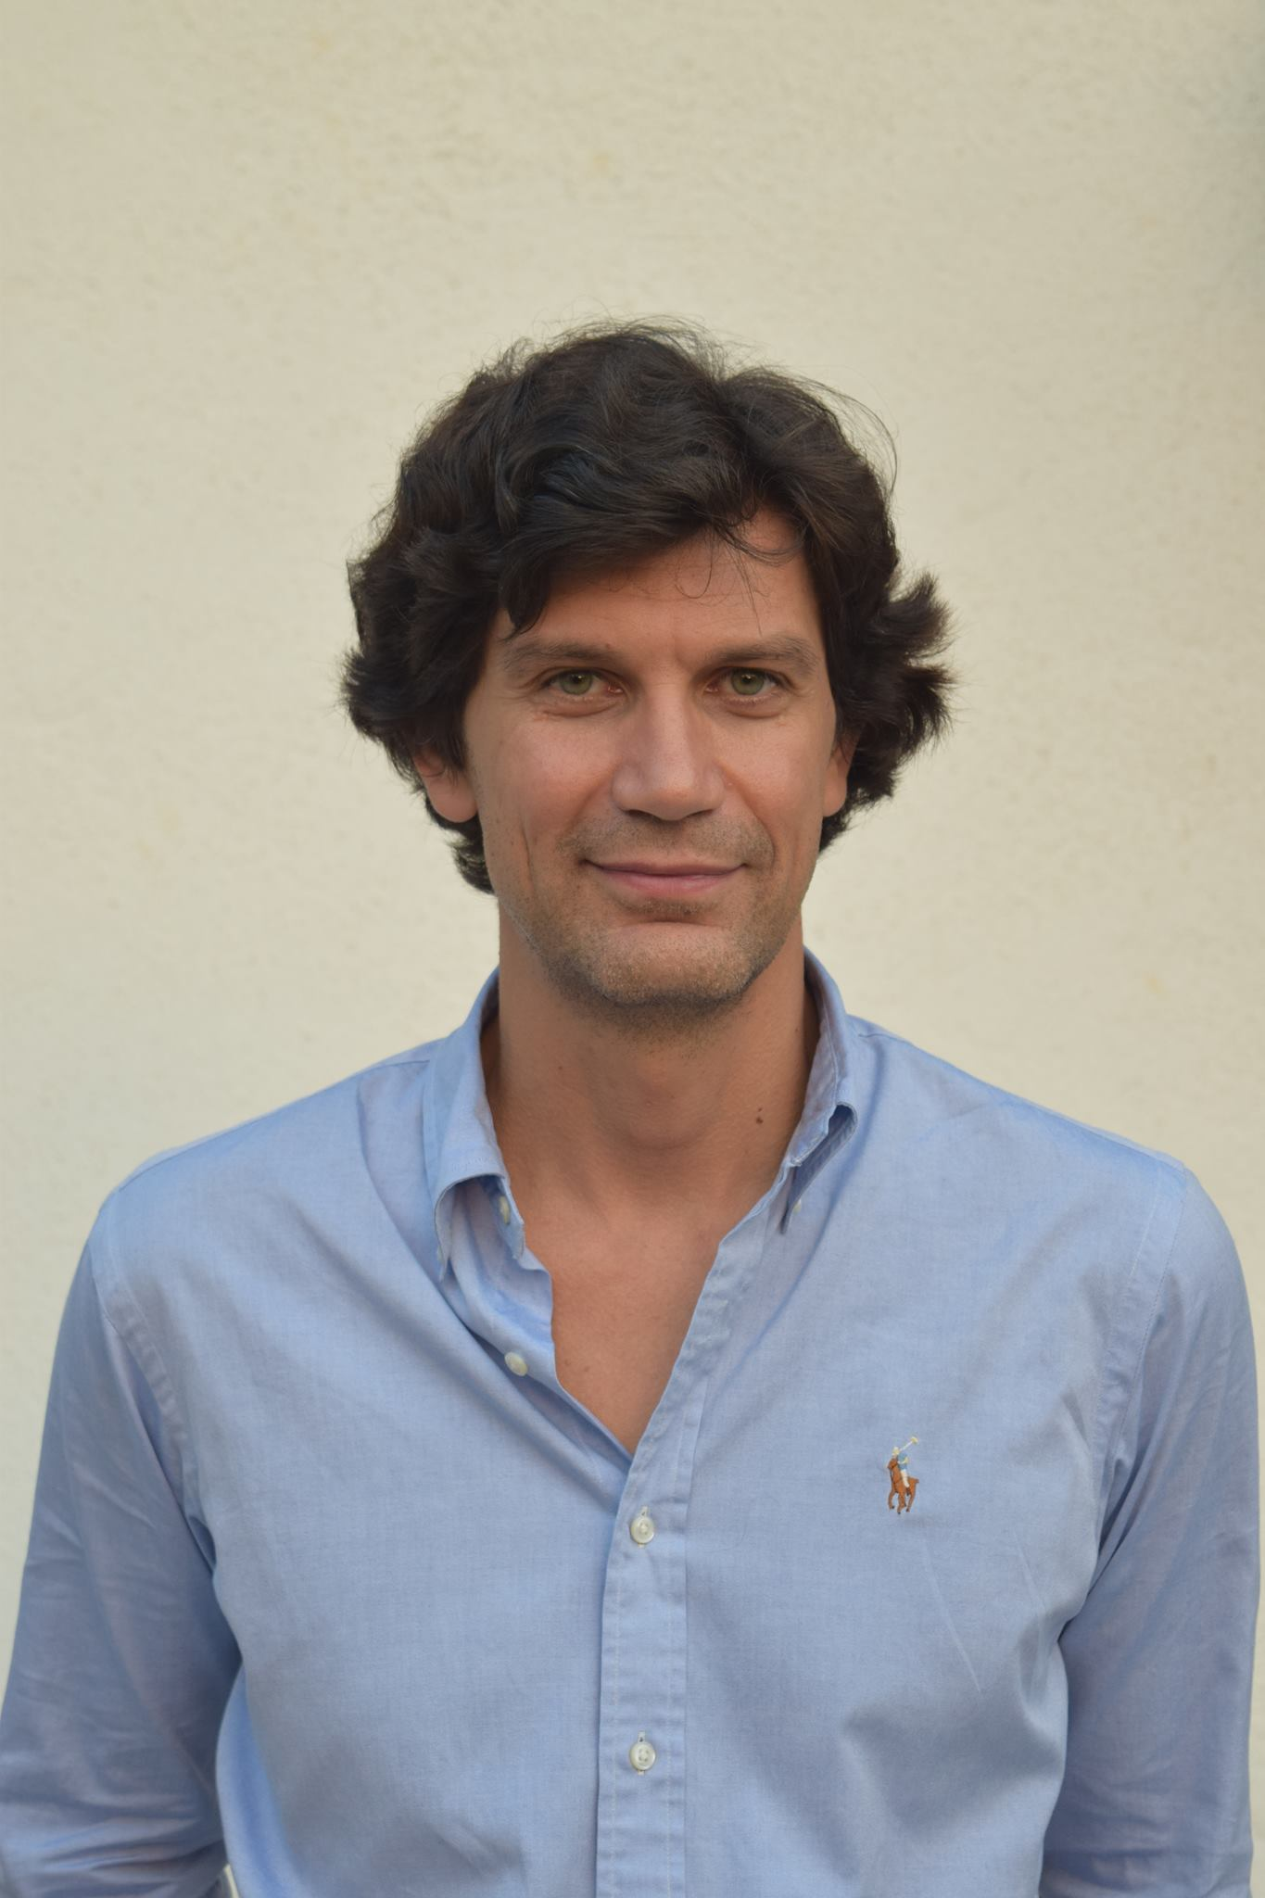
Dimitar Bakardzhiev is an expert in managing successful and cost-effective technology development. With his blend of technical, managerial and operational expertise, he effectively combines the theory and practice of Agile and Kanban Method to deliver business results.
Accredited Kanban Consultant (AKC),
Expert Kanban practitioner,
Brickell Key Award 2015 Finalist,
Published in Bulgarian - David Anderson’s Kanban book as well as books on Lean, Theory of Constraints and Deming's Theory of Management.
@dimiterbak

Slide 7



Slide 8
From Meilr Page-Jones Maturity Model
Scrum+Kanban Self-Assessment
How do you rate yourself?
Novice
Curious, No previous knowledge or information, “was asked to attend”
Informed
Have watched videos, Have read some web sites and/or articles
Apprentice
Read one or more books, 1 team implementation, < 6 months implementation experience
Practitioner
Good, 6 months – 18 months implementation experience
Journeyman
Larger scale implementations, multiple interdependent workflows & services, quantitative measures, etc.
Master
I can be teaching this class ☺ (Yes, we are glad to leverage your expertise).
Notes:
Traditional ways vs Kanban way

Slide 9
Scrumban game

Slide 10
The Scrumban Game is a fun way to practice evolutionary change in the context of software development. The game simulates the notorious and first ever Kanban case study about the XIT team at Microsoft.

Slide 11
In the game you will successfully improve the performance of your Scrum team by applying the Kanban method, while keeping the core Scrum process intact.

Slide 12
Your improvement efforts will go through three sprints
In the first sprint your goal is to understand and measure what is the current state of the system.
In the second sprint you decide to stop doing estimates and offer a Service Level Expectation (SLE) instead.
In the third sprint you introduce WIP limits and switch to on-demand replenishment of the Sprint backlog.

Slide 13
Context
The ERP system is in production.
The Scrum team works on bugs and small new features called Change Requests (CR) and Production Text Changes (PTC).
There are 3 (three) Product Owners represent 3 company departments.
The Scrum Master is one of the developers.
Sprints are 10 working days long.
All finished work can be released immediately thanks to CI/CD.

Slide 14
Scrum team roles
Development Team member. Manages the Sprint Backlog, keeps statistics, plans the sprint, starts, moves and completes user stories.
Product Owner. Manages the Product Backlog.
Scrum Master. One of the developers.

Slide 15
Sprint Workflow
Plan the Sprint
Populate the Sprint Backlog
Execute the Sprint
Run a Sprint Review
Run a Sprint Retrospective

Slide 16
Work types
Change requests (CR)
“Rough order of magnitude” (ROM) estimate
Production Text Changes (PTC)

Slide 17
CRs need both development and testing!

Slide 18
When during the sprint a new change request (CR) arrives it is sent to the Scrum Team for a “rough order of magnitude” (ROM) estimate.

Slide 19
ROM estimates are essential to facilitate both budgeting and prioritization.

Slide 20
All requests for ROM should be fulfilled per the Service Level expectation (SLE) of 2 days.

Slide 21
ROMs require only development time and no testing.

Slide 22
Production Text Changes (PTC)
Need only testing, no development.
PTCs have a fixed delivery date.

Slide 23
Scrum team goal is to deliver all CRs, PTCs and ROMs!

Slide 24
Visualizing the work of the Scrum team
Scrumban game

Slide 25
Classes of Service
Change requests (CR)
ASAP (in the Sprint)
“Rough order of magnitude” (ROM) estimate
SLE of 2 days
Production Text Changes (PTC)
Each has a fixed delivery date

Slide 26
Kanban board for the Scrum Team
Workflow
Backlog
Develop
Test Ready
Test
Done
Classes of Service
Standard
CR
SLE of 2 days
ROM
Fixed date
PTC
Work types

Slide 27
Rules for the game
Scrumban game

Slide 28

A die for each role
Dev Team member’s die
Product Owner’s die

Slide 29
Roll a die

Slide 30
Rule for developing a new CR
Get just one card from the “Backlog” column, put the current sprint day in the top right corner.
Move it into “Develop” column.
If the die rolls White then move it into the “Test Ready” column.
If the die rolls Green then leave it in the “Develop” column.
Customer’s clock started
Development started
1
2
CR#1

Slide 31
Rule for testing a new CR
Choose just one card from the “Test Ready” column and move it into “Test” column
If the die rolls White then move it into the Done column, put the day in the bottom right corner.
If the die rolls Green then leave it in the “Test” column.
Development started
Customer’s clock started
1
2
CR#1
5
Development finished

Slide 32
In case of new work from the events cards
Generate:
The requested number of ROMs of color pink and put them in the Backlog
The requested number of PTCs of color blue and put them in “Test Ready”
Write the number of work item in the center of a sticky note with PTC/ROM leaving room top and bottom.
Write the delivery day in the bottom left corner
Put the current sprit day in the top left corner.
1
1
ROM#1
PTC#1
2
5

Slide 33
Rule for preparing a new ROM
Choose just one card from the “Backlog” column, put the day in the top right corner and move it into “Develop” column.
If the die rolls White then move it into the Done column, put the day in the bottom right corner.
If the die rolls Green then leave it in the “Develop” column.
Estimation started
Customer’s clock started
1
2
ROM#1
Estimation finished
3

Slide 34
ROMs are top priority, but might not lead to developing a CR!

Slide 35
Rule for converting a ROM into a new CR
When the ROM card enters Done column roll the Product Owner die.
If the die rolls White then create a new CR card in the Backlog and put the day in the top left corner.
If the die rolls Blue then store the card in the Trash bin.
1
2
1
ROM#1
CR#1
3

Slide 36
PTCs need only testing!

Slide 37
Rule for testing a new PTC
Choose just one card from the “Test Ready” column, move it into “Test” column and put the day in the top right corner.
If the die rolls White then move it into the Done column, put the day in the bottom right corner.
If the die rolls Green then leave it in the “Test” column.
Testing started
Customer’s clock started
1
2
PTC#1
5
5
Testing finished

Slide 38
Metrics
Scrumban game

Slide 39
Tracking work
The day when the card entered Backlog / (Test Ready)
The day when the card entered Develop/ (Test)
0
1
{Card type}#{Card number}
The day when the card needs to enter Done
The day when the card entered Done
3
3

Slide 40
Example: Tracking CRs
The day when the card entered Backlog
The day when the card entered Develop
0
1
CR#1
The day when the card entered Done
3

Slide 41
Example: Tracking ROMs
The day when the card entered Backlog
The day when the card entered Develop
2
1
ROM#1
The day when the card entered Backlog + 2 days
The day when the card entered Done
4
3

Slide 42
Example: Tracking PTCs
The day when the card entered Test Ready
The day when the card entered Test
1
1
ROM#1
The day when the card needs to enter Done
The day when the card entered Done
5
3

Slide 43

Sprint #1
Sprint Planning
Sprint Goal and Sprint Backlog
20 Minutes
Sprint Execution
Time-box of 10 days.
Sprint Review
Review the Product Increment..
Retrospective
Identify improvements.

Slide 44
The Sprint
Sprint #1

Slide 45
Sprint planning
Sprint #1

Slide 46
What can be delivered?
In the “Backlog” column generate:
10 CRs of color yellow.
Write “CR” and the number of work item in the center of a sticky note. The number is continuous – from 1 to 10.
Put 0 in the top left corner leaving room top and bottom.
0
CR#1

Slide 47
The backlog is prioritized – deliver accordingly!

Slide 48
Sprint execution
Scrum Guide

Slide 49
Daily routine of the Sprint
Pick an event card and follow its instructions.
Each of the Dev team members should:
Move the card they will work on in the respective column with a die
Roll a die to see if the card can move to the next column to the right
Each team member moves the cards on the board according to the rules.
At the end of the day the Dev team collects CFD for the CRs.

Slide 50
A card cannot be moved more than once in the same day.

Slide 51
You can help each other!

Slide 52
Collect statistics : Cumulative Flow Diagram (CFD)

Slide 53
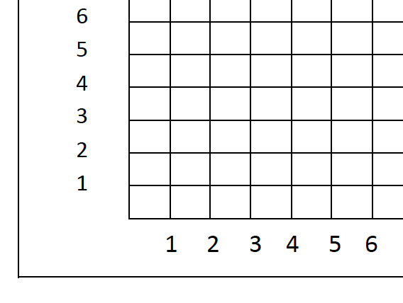
Backlog ( ) | Develop ( ) | Test Ready ( ) | Test ( ) | Done
2
2
Green line

Slide 54
Backlog ( ) | Develop ( ) | Test Ready ( ) | Test ( ) | Done
4
4
Blue line

Slide 55
Backlog ( ) | Develop ( ) | Test Ready ( ) | Test ( ) | Done
6
6
Red line

Slide 56
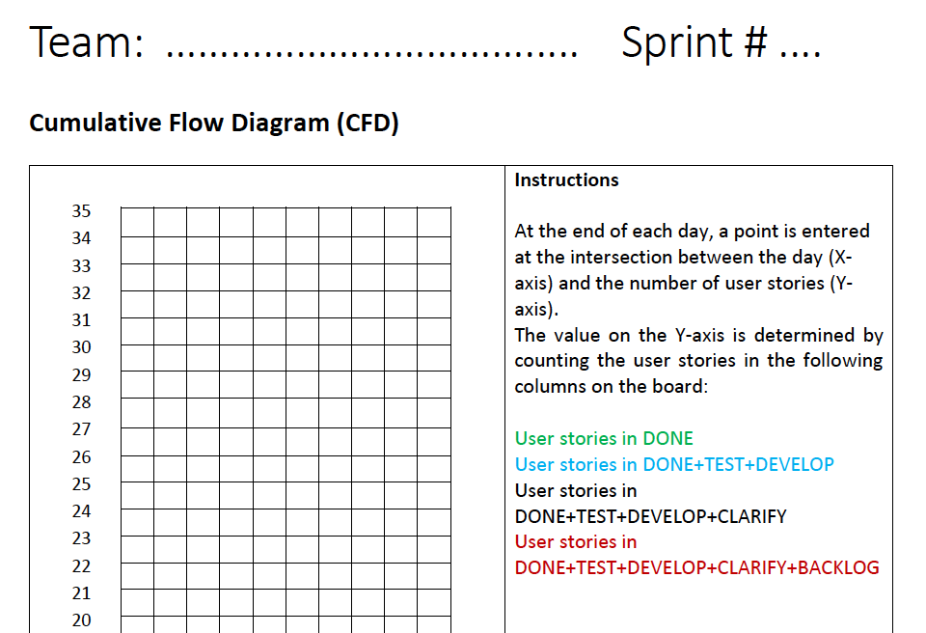
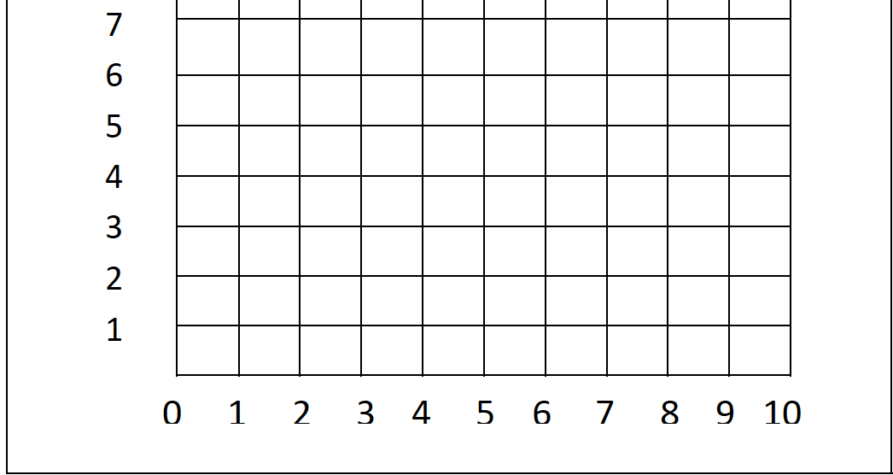
Day

Slide 57
Start!

Slide 58
End of the Sprint: collect statistics!

Slide 59
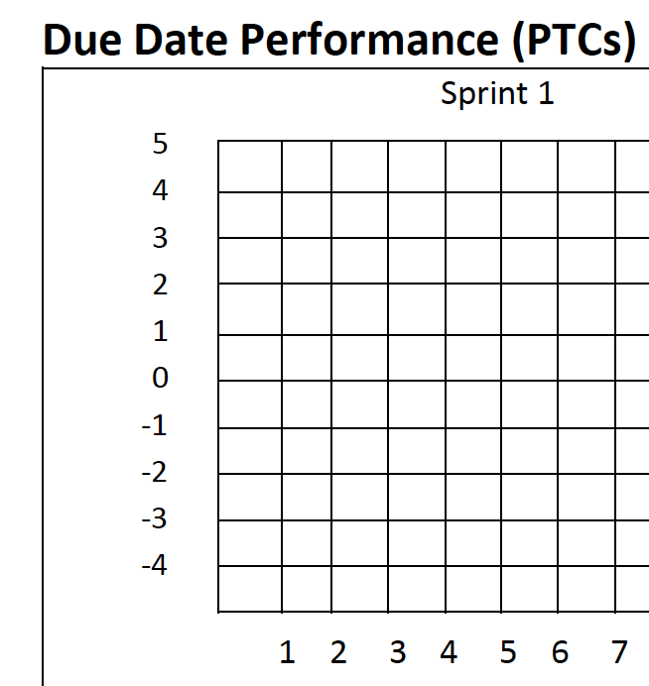
1
2
PTC#1
5
6
Due day- Done day
Due day
Done day
PTC #

Slide 60
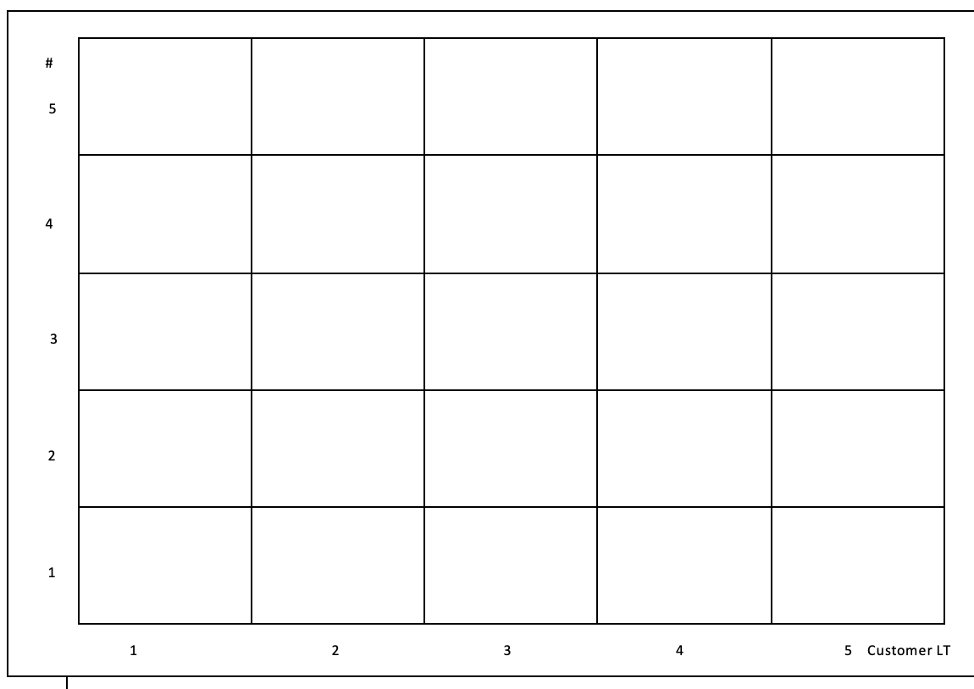
ROMs SLE performance
The day ROM was requested
SLE = 2 days
1
ROM#1
3
The day estimation finished
ROM#3
Customer Lead Time =
The day estimation finished
The day ROM was requested
If 0 or 1 then 1!
ROM#1
ROM#2
ROM#4
ROM#5

Slide 61
CRs Customer Lead Time
The day CR was requested
1
CR#1
3
CR#3
The day CR finished
CR#2
CR#6
Customer Lead Time =
The day CR finished
- The day CR was requested
If 0 or 1 then 1!
CR#1
CR#4
CR#5

Slide 62
Collect metrics (Lead Time)
Lead time = (Development Finished) – (Development started) = 5 – 2 = 3 days
Customer Lead time = (Development Finished) – (Customer’s clock started) = 5 – 1 = 4 days
Development started
Customer’s clock started
1
2
CR#1
5
Development finished

Slide 63
Sprint review
Scrum Guide

Slide 64
Sprint retrospective
Scrum Guide

Slide 65
How fit is the team for its purpose?
Service Level Agreements
Due date performance
What the data reveals?
CRs Customer lead time histogram
CRs throughput
PTCs Due Date performance
ROMs SLE performance

Slide 66
Problem Analysis
Scrumban game

Slide 67
Sources of dissatisfaction
Internal (Development team)
External (Product Owners)
Constantly interrupted to make estimates
Estimates are expected to be highly accurate and take time to develop
Testers occasionally swamped by PTCs cannot respond to developers
Small CRs take too long to develop
Delivery is completely unpredictable
Constantly breaking promises

Slide 68
Analysis results
ROM is non-value-added activity from CR Lead time perspective.

Slide 69
Changes
Stop doing ROMs - thus free capacity for Scrum Team.
Offer a SLE for the CRs instead based on the historical data. This way the Product Owners will be able to continue doing their prioritization.
Commit to deliver all the CRs!

Slide 70
Establish your SLE for CRs:
how many days with what probability?

Slide 71
Use Customer Lead Time Distribution to establish SLE for CRs
SLE = 7 days with 85% probability
85% on-time
15%
late
3-9 days spread of variation
Notes:
SLE (Service Delivery Effectiveness)

Slide 72
Kanban board for the Scrum Team
Workflow
Backlog
Development
Test Ready
Test
Done
Classes of Service
CRs
SLE
Fixed Date
PTCs
Work types

Slide 73
Sprint #2
Sprint Planning
Sprint Goal and Sprint Backlog
15 Minutes
Sprint Execution
Time-box of 10 days.
Sprint Review
Review the Product Increment..
Retrospective
Identify improvements.

Slide 74
Sprint planning
Scrum Guide

Slide 75
What can be delivered?
In the “Backlog” column generate:
10 CRs of color yellow.
Write “CR” and the number of work item in the center of a sticky note. The number is continuous – from 1 to 10.
Put 0 in the top left corner leaving room top and bottom.
0
CR#1

Slide 76
Sprint execution
Scrum Guide

Slide 77
Daily routine of the Sprint
Pick an event card and follow its instructions. If there is a ROM – create a new CR instead!
Each of the Dev team members should:
Move the card they will work on in the respective column with a die
Roll a die to see if the card can move to the next column to the right,
Each team member moves the cards on the board according to the rules.
At the end of the day the Dev team collects CFD for the CRs

Slide 78
A card cannot be moved more than once in the same day.

Slide 79
You can help each other!

Slide 80
Start!

Slide 81
Sprint retrospective
Scrum Guide

Slide 82
Collect all statistics!

Slide 83
How fit is the team for it’s purpose?
Service Level Agreements
Due date performance
What the data reveals?
Customer lead time SLE performance
CRs throughput
PTCs Due Date performance
Lead time(Engineering effort) histogram

Slide 84
Problem Analysis
Scrumban game

Slide 85
Current Queueing system
Scrum Team
PTC Customer Lead Time
PTC
PTC Test Ready
Product Owners
Unlimited
Done PTCs
PO #1
Dev
CR Test Ready
Test
Done CRs
Backlog
ROMs
PO #2
Unlimited
Unlimited
Prioritization
PO #3
CR Lead Time
CR Customer Lead Time
Unlimited queue
Commitment Point

Slide 86
Analysis results
There are two queueing systems – Product Owners and Scrum Team.
Both queueing systems are loosely-coupled (not one kanban system).
There is a gap between the CR commitment point and Development start point.

Slide 87
Changes
Limit all the queues. Thus create a kanban system from the two decoupled systems: Product Owners and Scrum Team.
Transfer the responsibility for the decision “What to work on next?” where it belongs to – the Product Owners.
Remove the gap between the CR commitment point and Development start point by making the Scrum Team commit to a delivery date only when a CR is actually picked by the Product Owners to be worked on next.
Stop reprioritizing the now limited Backlog. Thus eliminate the difference between Customer and Development lead times.

Slide 88
Changed Queueing system – a kanban system
Scrum Team
PTC Customer Lead Time
PTC
PTC Test Ready
Product Owners
Unlimited
Done PTCs
PO #1
Dev
CR Test Ready
Test
Done CRs
Backlog
ROMs
PO #2
Limited
WIP=2
Prioritization
PO #3
Limited WIP=3
CR Lead Time
CR Customer Lead Time
Unlimited queue
Commitment Point

Slide 89
Kanban board for the Scrum Team
Workflow
2
3
= 5 total
Backlog
Development
Test Ready
Test
Done
Classes of Service
SLE
CRs
Fixed Date
PTCs
Work types

Slide 90
Sprint #3
Sprint Planning
Sprint Goal and Sprint Backlog
15 Minutes
Sprint Execution
Time-box of 10 days.
Sprint Review
Review the Product Increment..
Retrospective
Identify improvements.

Slide 91
Sprint planning
Scrum Guide

Slide 92
Cadences for queue replenishments
Backlog queue – on-demand
QA CR Test Ready – on-demand
QA PTC Test Ready – on-demand

Slide 93
What can be delivered?
in the “Backlog” column generate:
2 CRs of color yellow.
Write “CR” and the number of work item in the center of a sticky note. The number is continuous – from 1 to 2.
Put 0 in the top left corner leaving room top and bottom.
0
CR#1

Slide 94
Replenishment
CRs get into Backlog on demand!
Add the new CRs at the end of each day.
Write “CR” and the number of work item in the center of a sticky note. The number is continuous – from 3 to 10.
Put 0 in the top left corner leaving room top and bottom.
0
CR#1

Slide 95
Sprint execution
Scrum Guide

Slide 96
Daily routine of the Sprint
Pick an event card and follow its instructions. If there is a ROM – ignore it!
Each of the Dev team members should:
Move the card they will work on in the respective column
Roll a die to see if the card can move to the next column to the right
Each team member moves the cards on the board according to the rules.
At the end of the day the Dev team:
collects CFD for the CRs.
If there are free slots in Backlog then the Dev team would replenish Backlog with new CRs.

Slide 97
A card cannot be moved more than once in the same day.

Slide 98
You can help each other!

Slide 99
Start!

Slide 100
Sprint retrospective
Scrum Guide

Slide 101
Collect all statistics!

Slide 102
How fit is the team for it’s purpose?
Service Level Agreements
Due date performance
What the data reveals?
Lead time(Engineering effort) histogram
Customer lead time SLE performance
CRs throughput
PTCs Due Date performance

Slide 103
Reflections

Slide 104
From Meilr Page-Jones Maturity Model
Scrumban Self-Assessment
How do you rate yourself, now?
Novice
Still know and understand very little about Scrum+Kanban.
Informed
Still know little or nothing more or beyond what I might have after watching a few videos and having read some web sites and/or articles
Apprentice
I am somewhat familiar with it now – and with help – I think I can start implementing it with my team.
Practitioner
I feel confident to start implementation of it for my team.
Journeyman
I feel confident to improve my existing Implementation.
Master
I feel confident enough to start training others in Scrum+Kanban.
Notes:
Traditional ways vs Kanban way

Slide 105


The End

Slide 106
Rule for developing a new work item
If the die rolls White | If the die rolls Green
Do one of: Advance one of the work items to the next column to the right OR help others | Leave the card in it’s current column

Slide 107
Rule for converting a ROM into a new CR
If the die rolls White | If the die rolls Blue
create a new CR card in the Backlog and put the day in the top left corner. | Store the card in the Trash bin.

